Slide 1
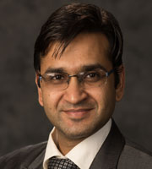
Dr. Rajiv Kaushal
Professor and Pathologist, Tata Memorial Centre
He received his medical degree from Grant Medical College, Mumbai
Completed his residency training in pathology at TMH, Mumbai & PGIMER, Chandigarh and joined TMH as faculty in 2012
Special interests: Thoracic, Gastrointestinal Oncopathology, Molecular pathology and Digital pathology
He is a recipient of the Terry Fox Research Grant(Canada) & Geraldine C. Zeiler fellowship from Mayo Clinics
He had many publications in national and international journals to his credit.

